Slide 1
Citi Bike
Docking Station Hourly Scoring
Chunqing Xu
Graduate Student
Center for Urban Science + Progress
NYU

Slide 2
Data
Citi Bike Trip Histories from Citi Bike System Data Web Page
Start Time, Stop Time,
Start Station ID, End Station ID

Slide 3
Scoring Function
1. Data Processing
Each station, Each hour
One trip arriving +1, One trip leaving -1
Added Value = 1 x (Number of Trips Arriving ) -1 x (Number of Trips Leaving)

Slide 4
Scoring Function
2.Formula
For each station, at time N
Prescore at N = Added Value at N-1 + Added Value at N-2 + Added Value at N-3
For all stations, at time N
Prescores at N would be a vector
Sorted Prescores in the vector

Slide 5
Scoring Function
3.Scoring
Set the scoring standard:
Match the sorted prescores vector with the scoring standard
Score | -3 | -2 | -1 | 0 | 1 | 2 | 3
Percentage | %5 | %10 | %10 | 50% | 10% | 10% | 5%
Notes:
Fixed Number of Bikes

Slide 6
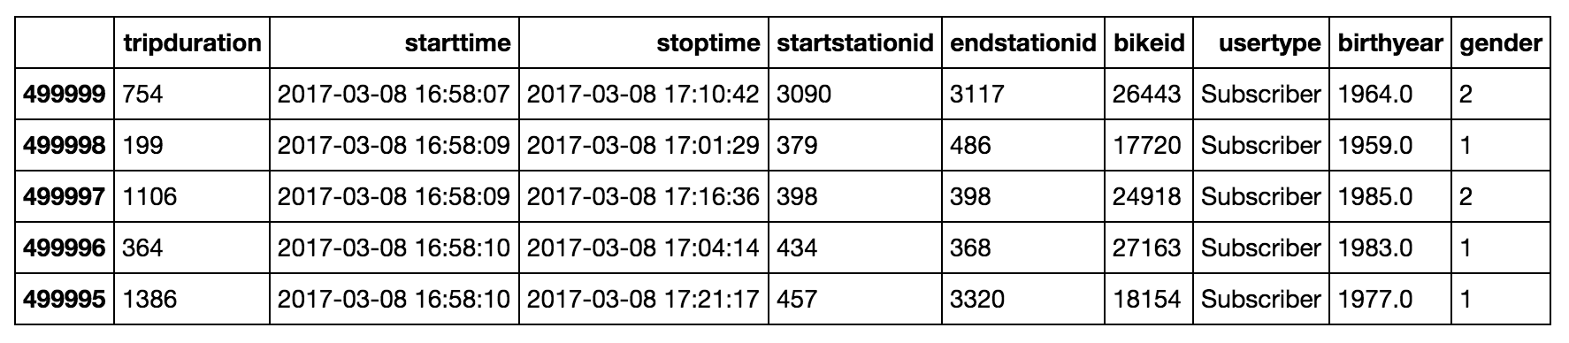
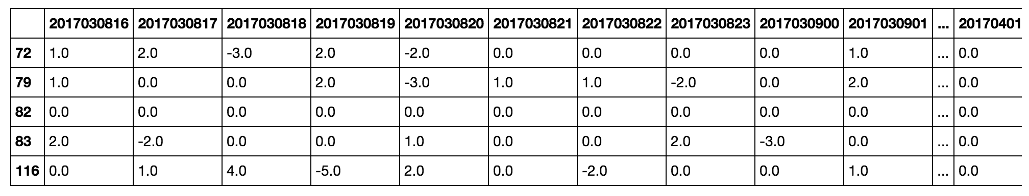
Enough of theories! How does it operate?
Demo
1.Data Processing

Slide 7
Demo
2.Scoring Function
score(dh, df, w)
dh - Date Hour to score “2017030821”
df - Data Frame of Prescores (Station ID x Date Hour)
w - Scoring Standard w = [0.05, 0.1, 0.1, 0.5, 0.1, 0.1, 0.05]

Slide 8
Demo
3.Scoring example
score(dh, df, w)
dh - '2017030821' - "2017030905"
df - Prescores of 616 Citi Bike Stations at N-1, N-2 and N-2
w - w = [0.05, 0.1, 0.1, 0.5, 0.1, 0.1, 0.05]

Slide 9

Demo
4.Scoring Table

Slide 10
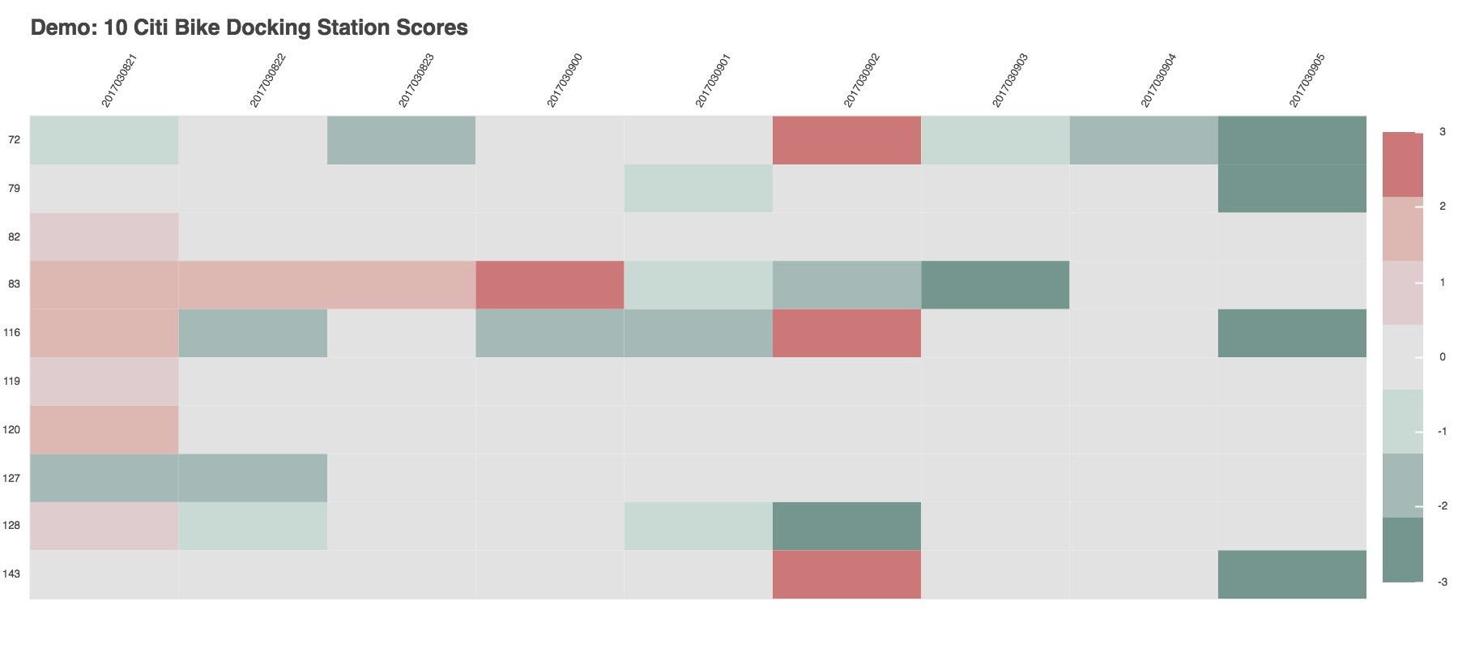
Demo
5.Visualization （interactive）

Slide 11
Conclusion
Score of a certain hour of Citi Bike Stations
=
Scoring standard
+
Prescores of the past three hours *
Notes:
In this scoring system

Slide 12
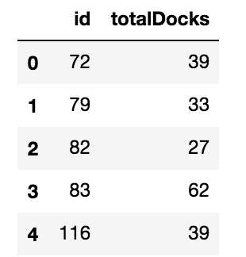
Improvement on Scoring Function
Normalized Prescores Table

Slide 13
Future Works
Scoring Function
Panel Regression
ARMA
Notes:
Once difficulty - > machine learning / different models would be easy

